Slide 1
Reproducible computational methods
Oscar Ramfelt
oramfelt@Hawaii.edu

Slide 2
Why the shell is your best friend
Oscar Ramfelt
oramfelt@Hawaii.edu

Slide 3

Core Ideas
Reproducible code is important
Using the shell can make this easier to achieve

Slide 4
Why Now?
Dataset Size
Speed
Reproducibility

Slide 5
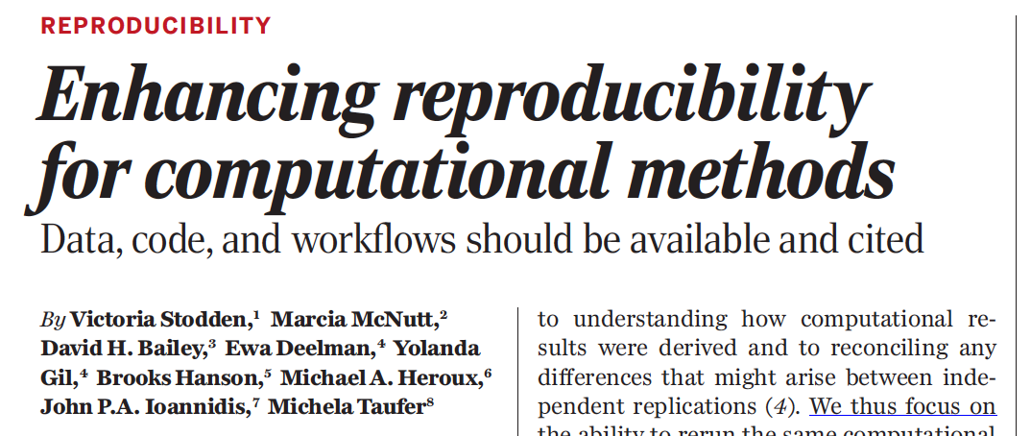
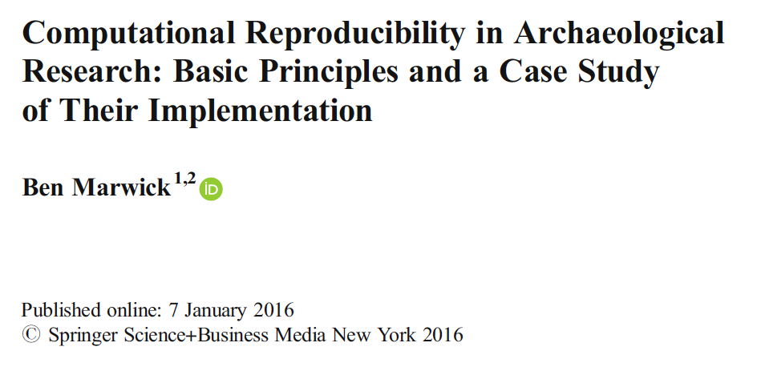
Why care?
We do this for sampling and statistical methods already
Why not do the same for analysis of the data?
Anyone who has wanted to use a new method
Can cause big issues

Slide 6
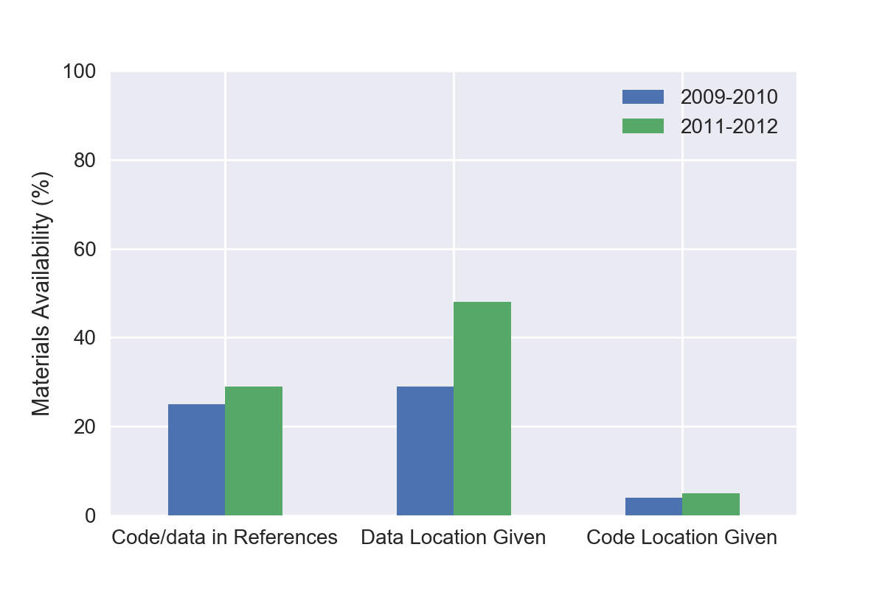

Why care?
We do this for sampling and statistical methods already
Why not do the same for analysis of the data?
Anyone who has wanted to use a new method
Can cause big issues
Stodden et al. 2017
https://techxplore.com/news/2019-10-team-glitch-affect-scientific.html

Slide 7
Computation Pipeline
Sequence of processing steps that filter and transforms raw data into finalized results/figures
Result Figure
Raw Data File
Intermediate File 1
Intermediate File 2
Result
Files/Figures
Filter
Computation
Computation
Notes:
Pipelines can be manual or automatic

Slide 8
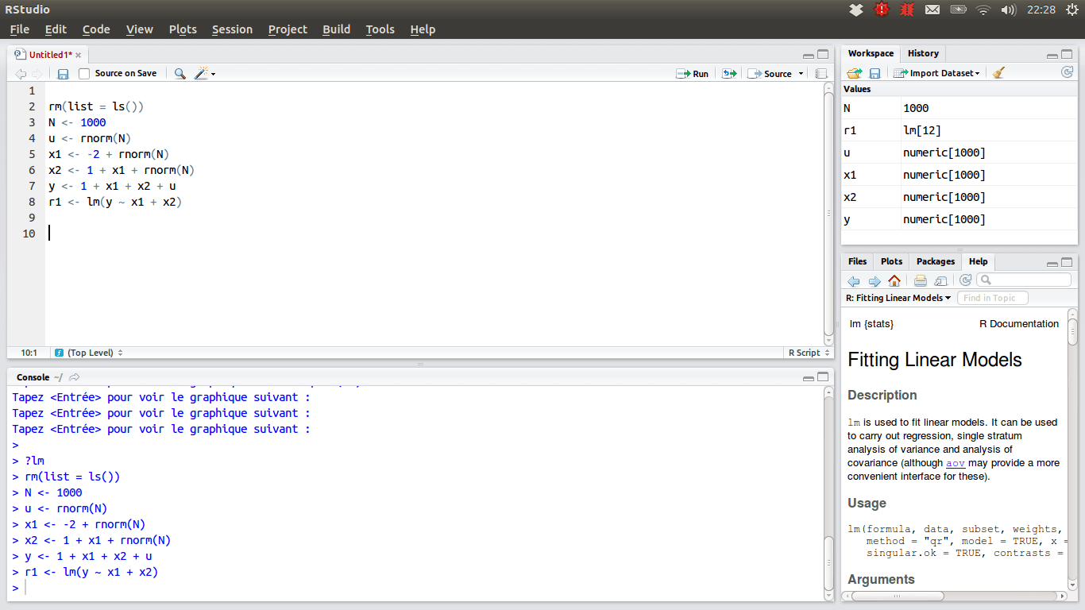
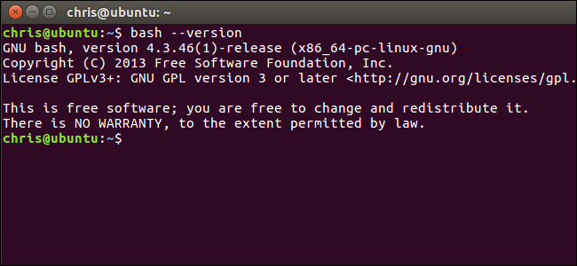
The Shell
Why start here?
Always present, even when using GUI interfaces e.g. R studio, atom, Pycharm, etc.
Direct interface to commands
Server interface
A shell script is code that runs directly in the shell

Slide 9
Example what a Shell script can do
Start script:
Login to remote server
Copy dataset to server
Start processing pipeline on server
Logout from server leaving pipeline to run
Come back after weekend and it is finished!

Slide 10
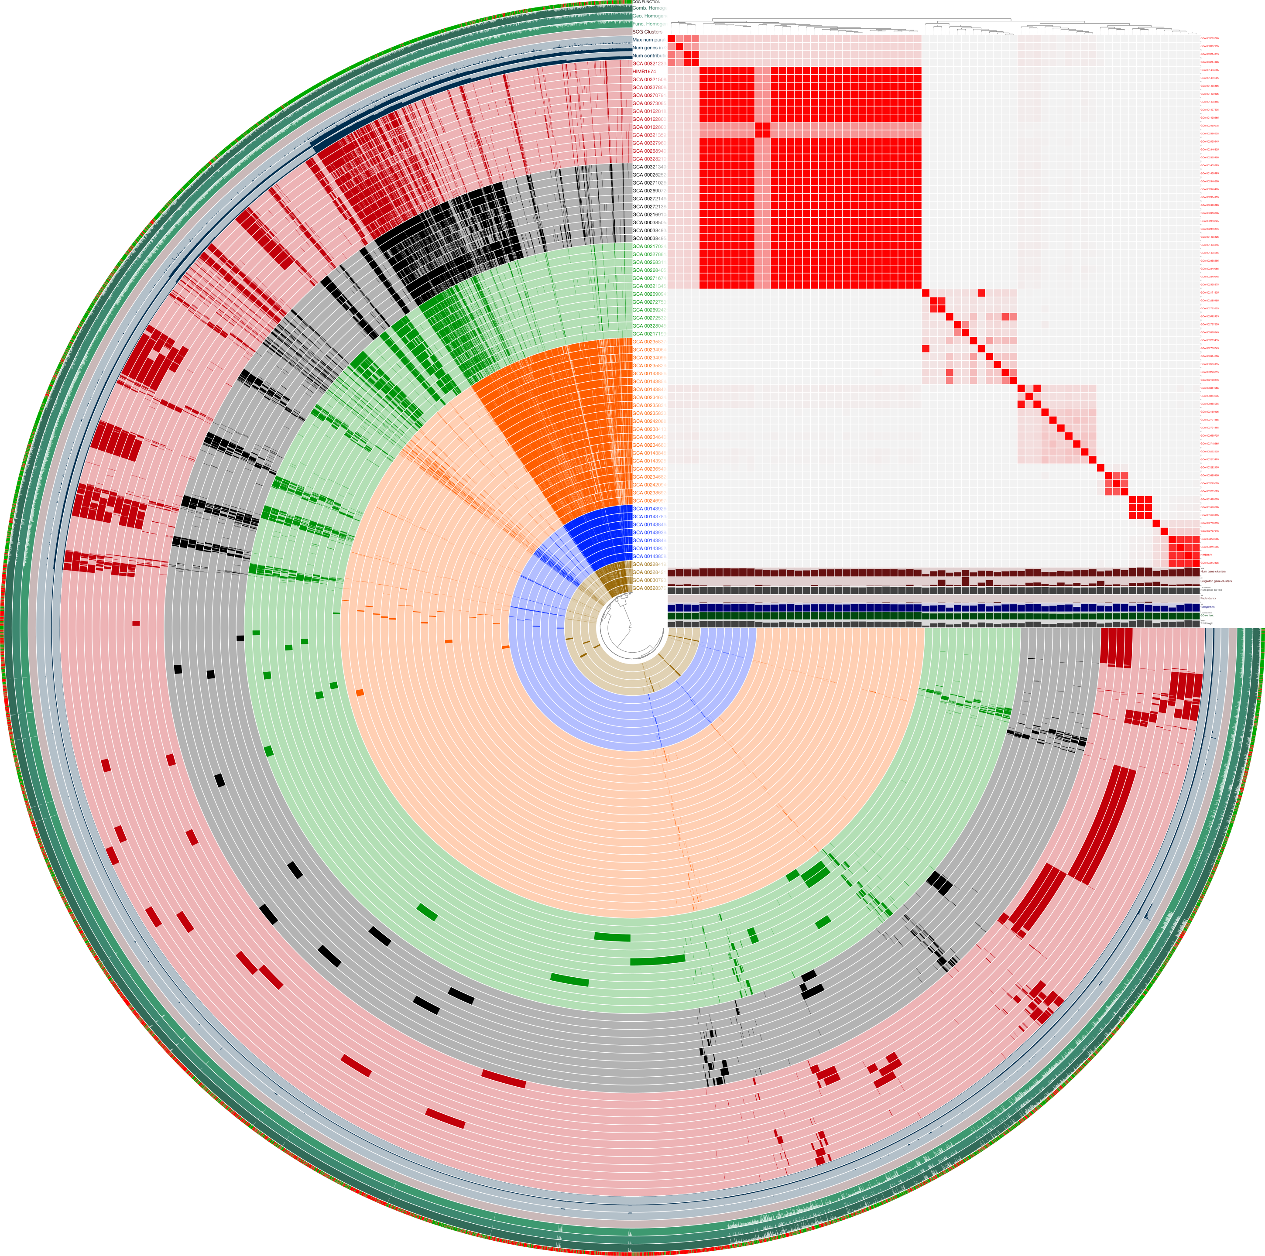
Example what a Shell script can do
Start script:
Login to remote server
Copy dataset to server
Start processing pipeline on server
Logout from server leaving pipeline to run
Come back after weekend and it is finished!

Slide 11
But When I say shell, What do I mean?
Shell
Command line, terminal, shell, etc.
What do they mean?
Different types of “shells”
Bash
Zsh
sh
Command Line(s)

Slide 12


What does the shell have access to?
Shell
Files
External Programs
Operating System
Notes:
Has access to pretty much everything on your computer. It allows you to even break it if you aren’t careful.

Slide 13
When you start a shell
Oscar
Starting Point
You start at some location, usually a directory with the same name as you
Directories are just a different name for folders
Same files and folders that you are used to
Directory1
File1.txt
Directory2
A Directory
File2.txt
File3.txt
A File

Slide 14
Three commands
cd
Allows you to change directories (i.e. folder)
ls
Shows the current folders contents
pwd
Tells you where you currently are on the computer

Slide 15
How does this actually look?
ROOT
Starting Point
Directory1
File1.txt
Directory2
A Directory
File2.txt
File3.txt
A File

Slide 16
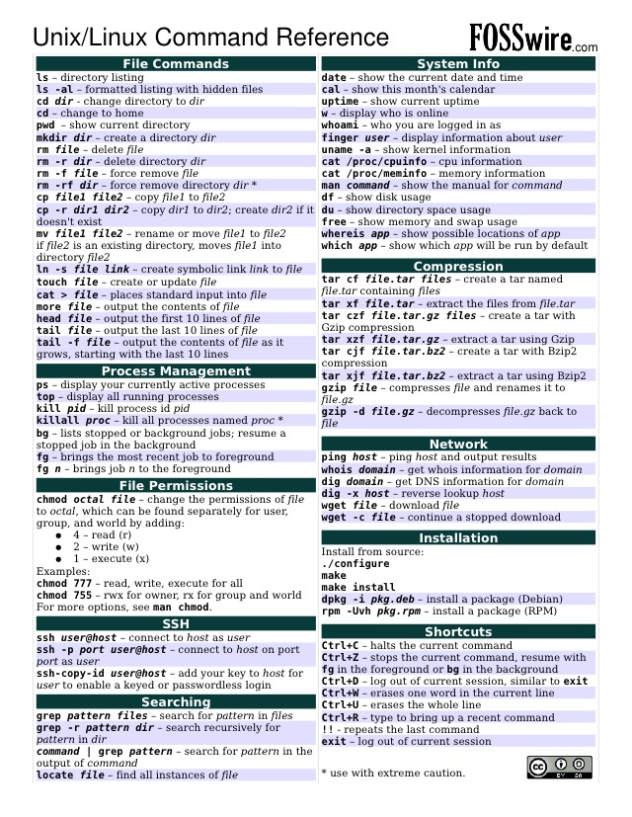
Why stop with only three commands?
There are many commands that do tons of different things
However, depending on what you do these commands will differ in importance
cd, ls, and pwd are three commands that are so central that you can’t really do much without them
https://files.fosswire.com/2007/08/fwunixref.pdf

Slide 17
remote servers
Computer
script
Test Script using shell or
a GUI
Working with remote servers is one highlight of shell scripting using SSH/SCP
Write up workflow locally and then run it on a server
Disconnect from server and go about your day
Copy script to server
script
Run script using shell
Server

Slide 18
General Takeaways
Reproduce and reuse code across operating systems
Efficiently reproducing longer workflows/pipelines
Connect code output from different languages

Slide 19
In context
Here I barely scratched the surface of important details regarding using the shell
What I have
What I haven’t talked about

Slide 20
Beyond shell coding
Versioning of scripts
Environment of scripts
Tracking intermediate files
Documentation of code and data so that other people can use/run it
Making sure that both code and data are accessible

Slide 21





Luckily there are many tools available
Virtual Environments
Jupyter notebook
Git/Github
Docker

Slide 22
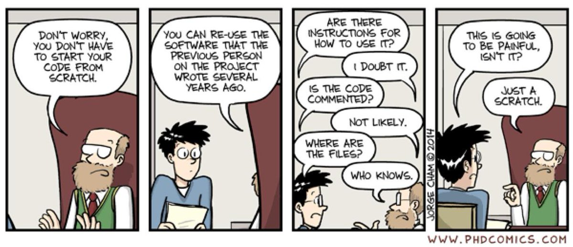
And If nothing else, do it for a fellow student

Slide 23
References
Cloern, J., & Soranno, P. (2019). ASLO Takes a Next Step toward Open Science: Introducing Data Papers, a New Article Type in Limnology & Oceanography Letters. Limnology and Oceanography Bulletin.
Marwick, B. (2017). Computational reproducibility in archaeological research: basic principles and a case study of their implementation. Journal of Archaeological Method and Theory, 24(2), 424-450.
Soranno, P. A. (2019). Six Simple Steps to Share Your Data When Publishing Research Articles. Limnology and Oceanography Bulletin, 28(2), 41-44.
Stodden, V., McNutt, M., Bailey, D. H., Deelman, E., Gil, Y., Hanson, B., ... & Taufer, M. (2016). Enhancing reproducibility for computational methods. Science, 354(6317), 1240-1241.
Stodden, V., Seiler, J., & Ma, Z. (2018). An empirical analysis of journal policy effectiveness for computational reproducibility. Proceedings of the National Academy of Sciences, 115(11), 2584-2589.
University of Hawaii (2019). Team finds glitch that could affect more than 100 scientific studies. Techxplore (https://techxplore.com/news/2019-10-team-glitch-affect-scientific.html)
Additional Resources
Introduction to Unix – https://astrobiomike.github.io/unix/unix-intro
A guide to reproducible Code in Ecology and Evolution - https://www.britishecologicalsociety.org/wp-content/uploads/2017/12/guide-to-reproducible-code.pdf
Buffalo, V. (2015). Bioinformatics data skills.

Slide 24
Cores
Ram
Disk
Laptop | Server | HPC*
1-4 | 4-24 | 20-1000
Laptop | Server | HPC*
8-16Gb | 16-64Gb | 128Gb-1Tb
Laptop | Server | HPC*
512Gb-1Tb | 1Tb-20Tb | Variable
HPC based on UH Manoa cluster:
https://www.hawaii.edu/its/ci/hpc-uh-it-services/
*HPC = High Performance Cluster

Slide 25
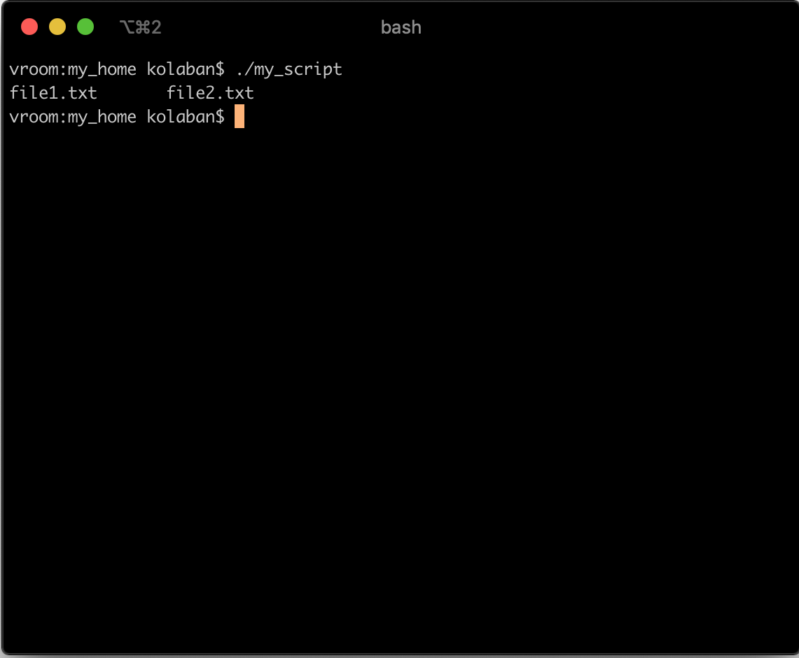
Shell scripting
my_script
1. cd directory1/
2. ls
3. cd ../
Shell scripting allows you to write out commands that you want the computer to do and then have it run
These can be an entire workflow for data analysis or simply a quick command that you use regularly

Slide 26
Why now?
Computers are becoming important parts of data analysis
Workflows and methods depend on outputs from programs that can be complex
Increasing amounts of data to work through
Reuse another labs computational methods

Slide 27
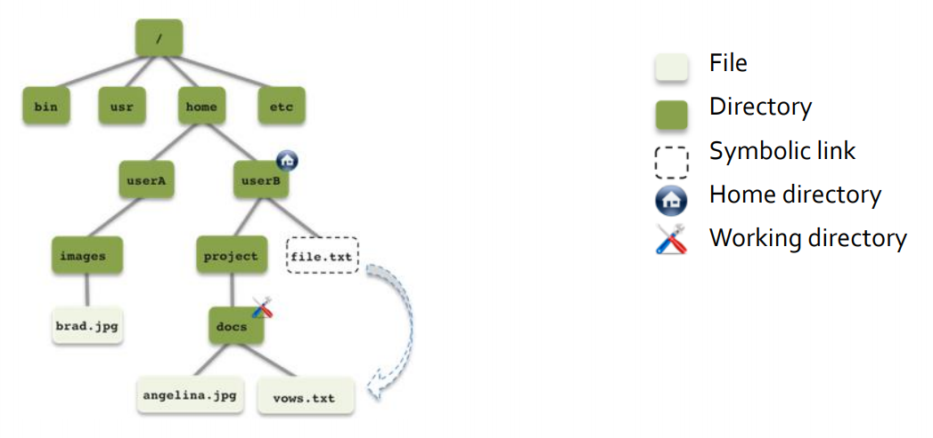
When you start a shell
Starts you at some location on your computer
Directories are just a different name for folders
https://yulijia.net/slides/bioinfomatcis_for_medical_students/2019-06-17-Introduction_to_Linux_for_Bioinformatics.html#1

Slide 28
Outline
Why care?
Where to start?
Basics of the shell
Overall context
Tools and resources

Slide 29
Core Ideas
Reproducible code is important
Using the shell can make this easier to achieve

Slide 30
Why now?
Size of Data sets
Reusability
Speed of Analysis

Slide 31
Why now?
Size of Data sets
Reusability
Speed of Analysis
Reproducibility

Slide 32
But When I say shell, What do I mean?
Shell
Operating System
user$ ls
Command line, terminal, shell, etc.
What do they mean?
Different types of “shells”
Bash
Zsh
sh
Command Line

